Slide 1
Data Visualization - A1
By- Akanksha (DT2023001), Ketki Bhatia (DT2023007), and Niharika Suri (DT2023015)
GROUP-DIGITAL SOCIETY

Slide 2
Methodology

Slide 3
The workflow began with an initial inspection of the dataset, followed by data preprocessing and cleaning.
Feature engineering was then applied, particularly with the calculation of age, and job types were categorised for further analysis.
1
2
As a part of hypothesis we focused on New York (NY), Pennsylvania (PA), Texas (TX), and California (CA) to assess whether the proportion of fraudulent transactions (is_fraud) varies significantly between these regions.
For creating customised visualisation depending upon the need we have created some calculated fields using the variables present in the dataset (age, generation, age in range, is fraud (only 1)
3
4

Slide 4
Visualization Workflow

Slide 5
States and Credit Card Transaction
Standard Deviation
States with Low CC Transaction
States with High CC Transaction

Slide 6
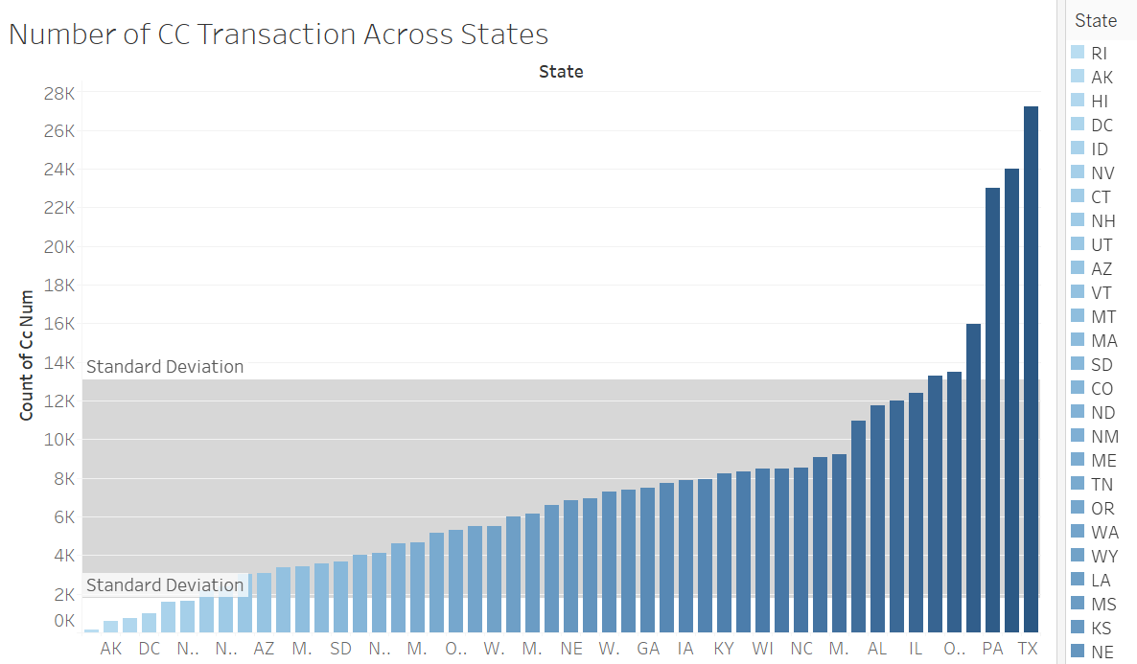

Slide 7
States and Credit Card Transaction
Standard Deviation
States with Low CC Transaction
States with High CC Transaction
AK
DC
HI
ID
NV
RI
CA
MI
OH
PA
NY
TX

Slide 8
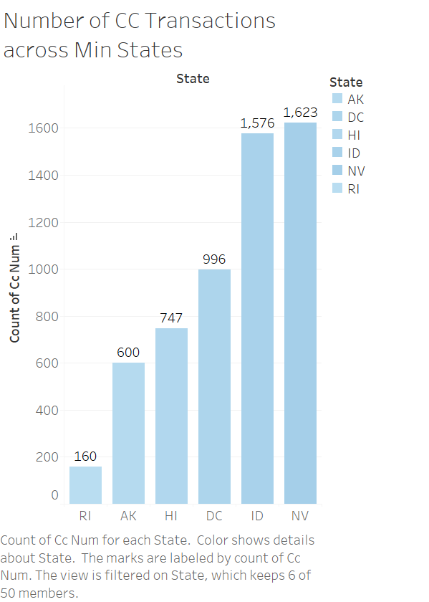
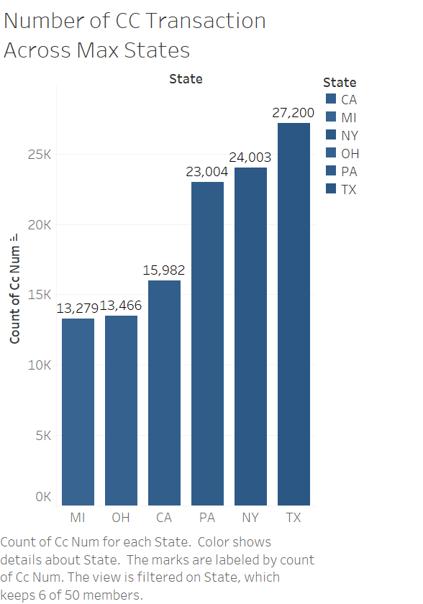
Number of CC Transactions Across Min States
Number of CC Transactions Across Max States

Slide 9
Is_fraud only 1
Regions with Highest CC Fraud
High Concentration toward Eastern and Midwestern States

Slide 10
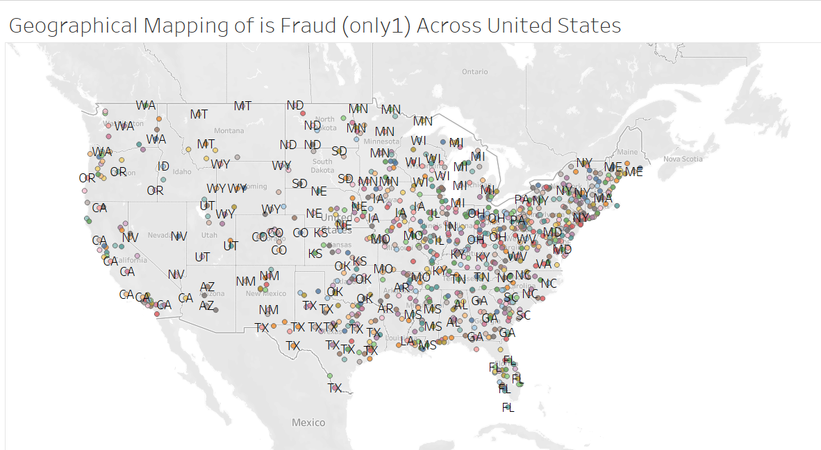
Geographical Mapping of is Fraud (only1) Across United States

Slide 11
Is_fraud only 1
Regions with Highest CC Fraud
High Concentration toward Eastern and Midwestern States
Gender and CC Fraud
Females are more susceptible to fraud

Slide 12
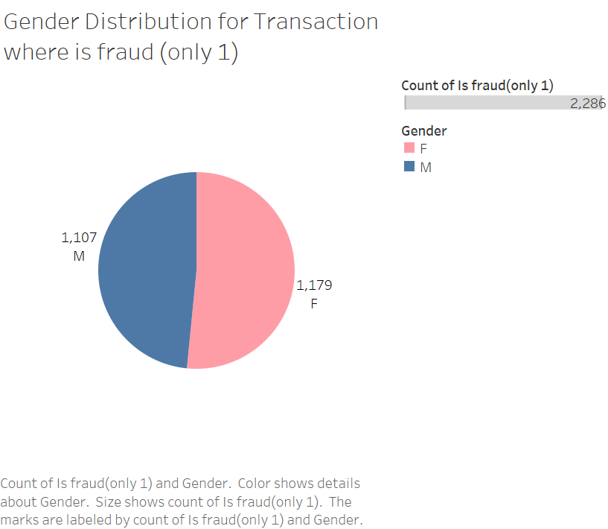
Gender Distribution for Transaction where is Fraud (only1)

Slide 13
Is_fraud only 1
Regions with Highest CC Fraud
High Concentration toward Eastern and Midwestern States
Gender and CC Fraud
Females are more susceptible to fraud
States with Low CC Transaction
States with High CC Transaction

Slide 14
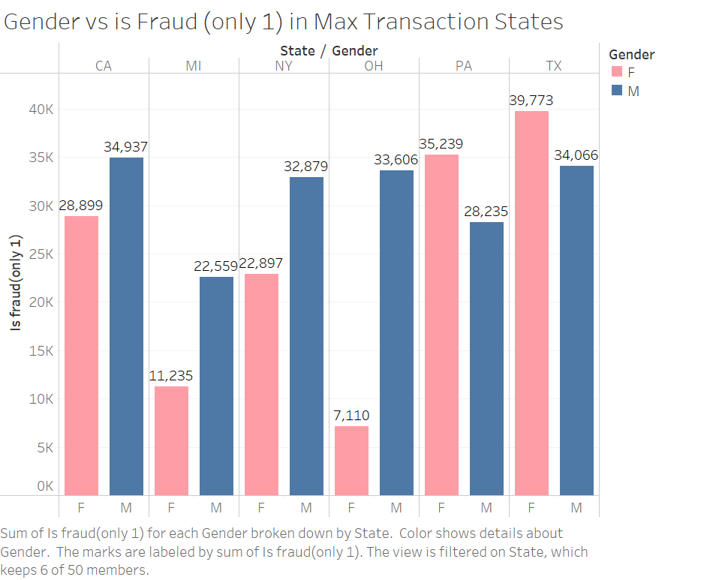
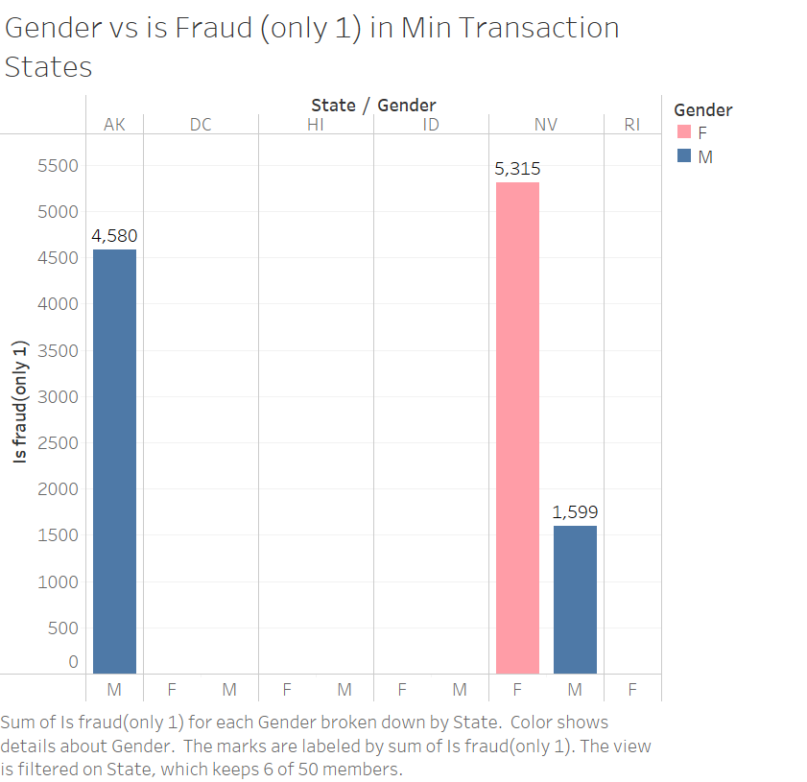
Gender vs is Fraud (only 1) in Max Transaction States
Gender vs is fraud (only 1) in Min states

Slide 15
Is_fraud only 1
Regions with Highest CC Fraud
High Concentration toward Eastern and Midwestern States
Gender and CC Fraud
Females are more susceptible to fraud
States with Low CC Transaction
States with High CC Transaction
States with Low CC Transactions were removed

Slide 16
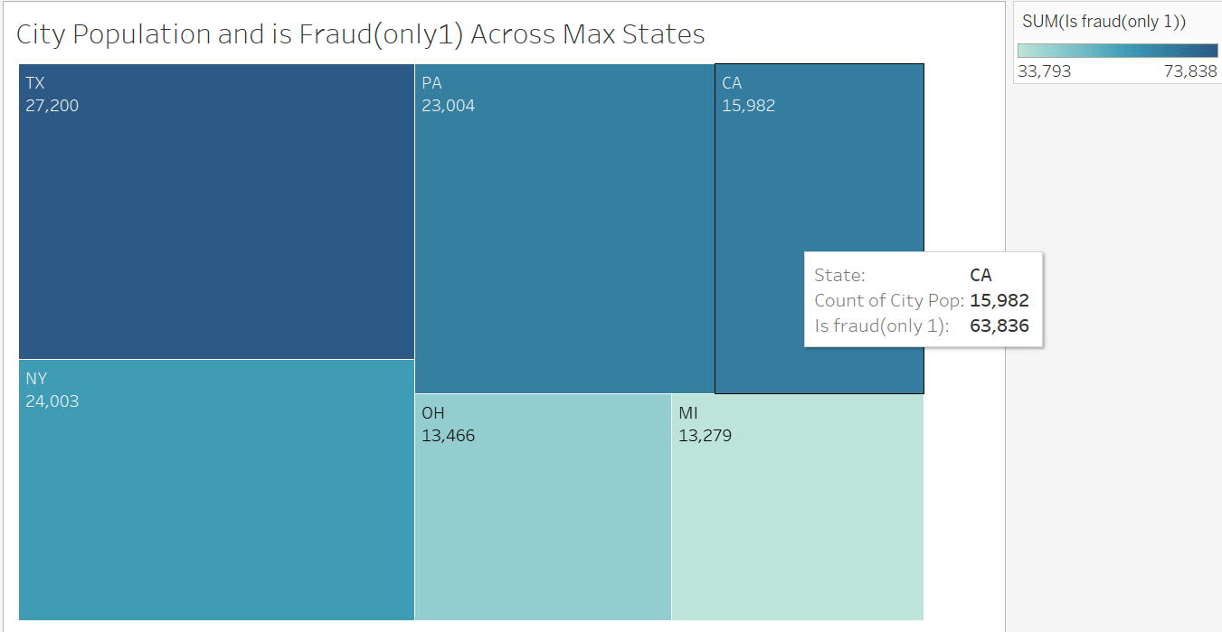
City Population and is Fraud (only 1) Across Maxx States
City Population and is Fraud (only 1) Across Max States

Slide 17
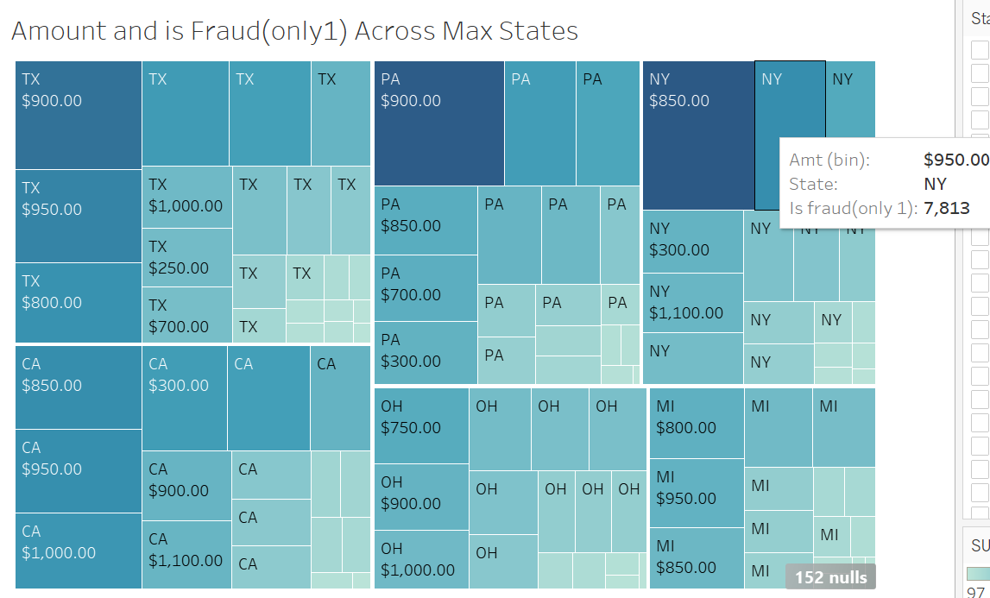
Amount and is Fraud (only 1) Across Maxx States
Amount and is Fraud (only 1) Across Max States

Slide 18
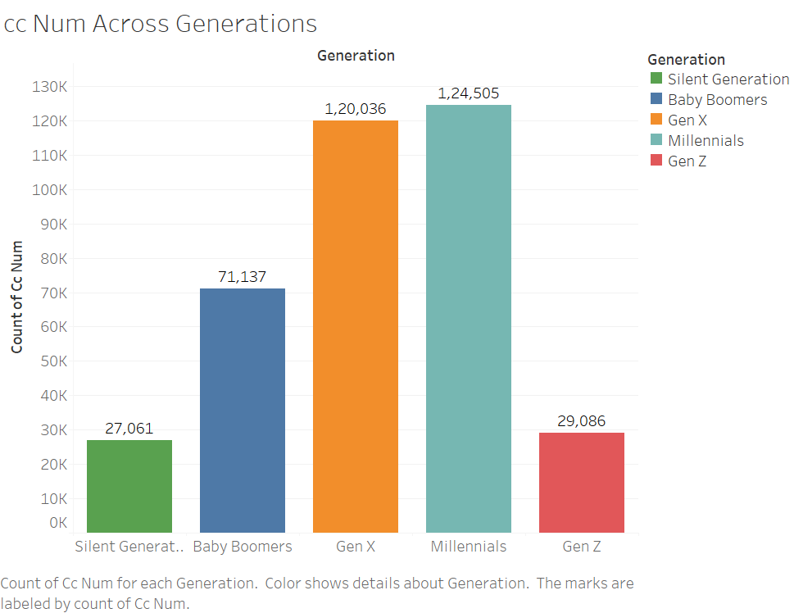
Is_fraud removed
Credit Card Transaction across Generation
ccNum Across Generations

Slide 19
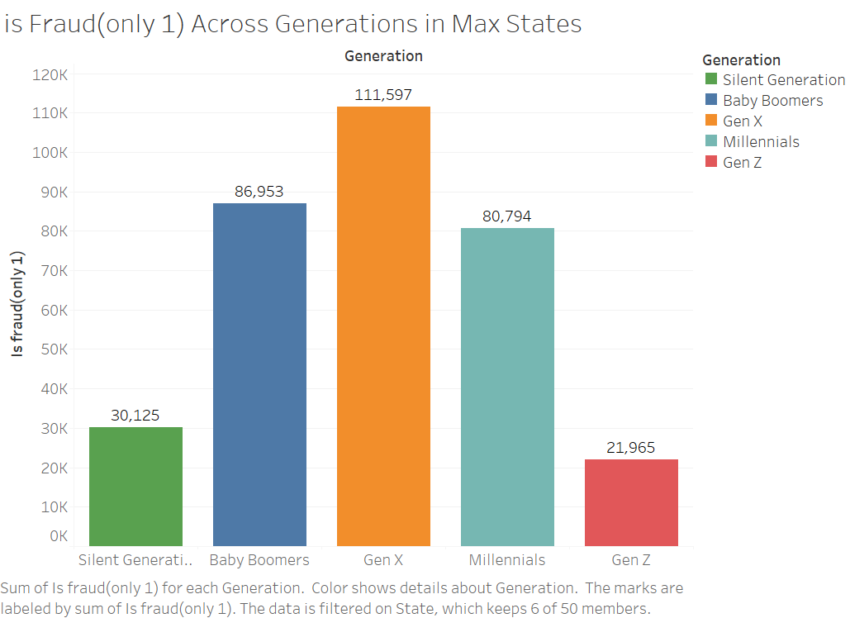
Is_fraud only 1
is Fraud (only 1) Across Generations
is Fraud (only 1) Across Generations in Max States

Slide 20
Is_fraud only 1
is Fraud (only 1) Across Generations
Age in Range Across Merchant Categories
Age in Range Across Job Categories

Slide 21
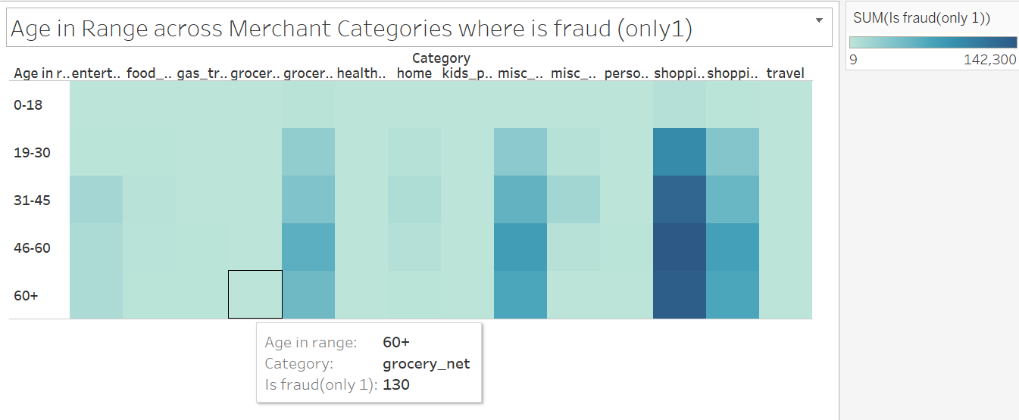
Age in Range Across Merchant Categories where is fraud (only 1)

Slide 22
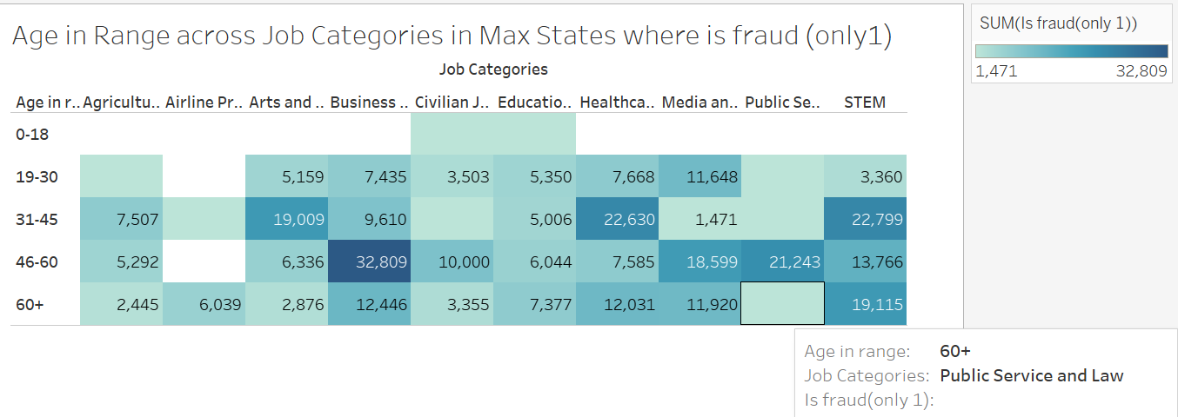
Age in Range across Job Categories in States where is fraud (only1) in Max States

Slide 23
Conclusion
Fraud is concentrated in economically significant states like NY, PA, MI, and OH, with regional economic dynamics playing a more crucial role than population size.
Gender, age, and job categories significantly impact fraud vulnerability, with men in states like NY and OH being more affected, while women face higher fraud occurrences in TX and PA.
Fraudsters target transaction amounts between $800–$950 to bypass conventional detection systems.
Hypothesis Validation: The analysis supports the alternate hypothesis, revealing significant fraud variation across states, driven by economic, demographic, and transactional factors, thereby rejecting the null hypothesis.

Slide 24
Thank You !

